Slide 1
Current Return:
The Path of Least IMPEDANCE
John McCloskey
NASA/GSFC Chief EMC Engineer
Code 565
301-286-5498
John.C.McCloskey@nasa.gov

Slide 2
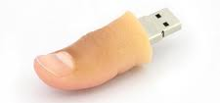
Kirchhoff’s Current Law
All currents return to their sources following path of least IMPEDANCE
  NOT always path of least resistance
Currents do NOT return to ground
  They may use ground as the return path to their source, if that is the path of least impedance
BIG Rule of Thumb for EMC: “Follow the current”

Slide 3
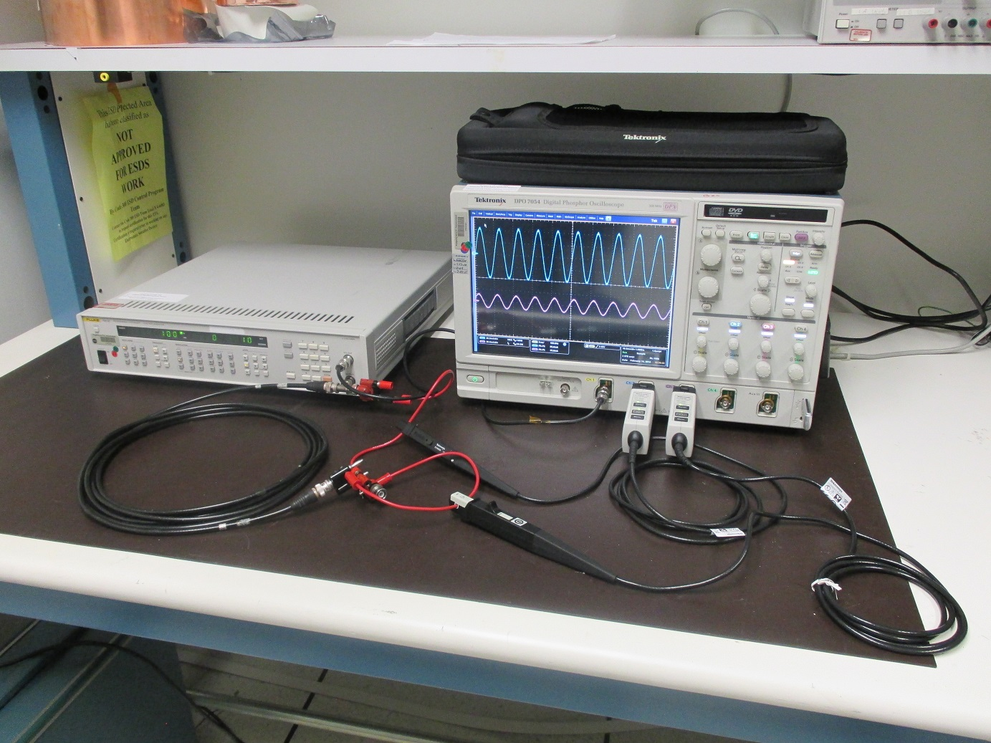
Current Return Path Test Setup
Which path will the return current take?
I_{C}
COAXIAL CABLE
V₀
I_{C} = center conductor current
I_{S} = shield return current
I_{C} = ground shunt wire return current
I_{S}
50 Ω
GROUND SHUNT WIRE
I_{G}
Tektronix DPO7054 oscilloscope
Fluke PM5193 signal generator
NO ground plane
Tektronix TCP0030 current probes

Slide 4
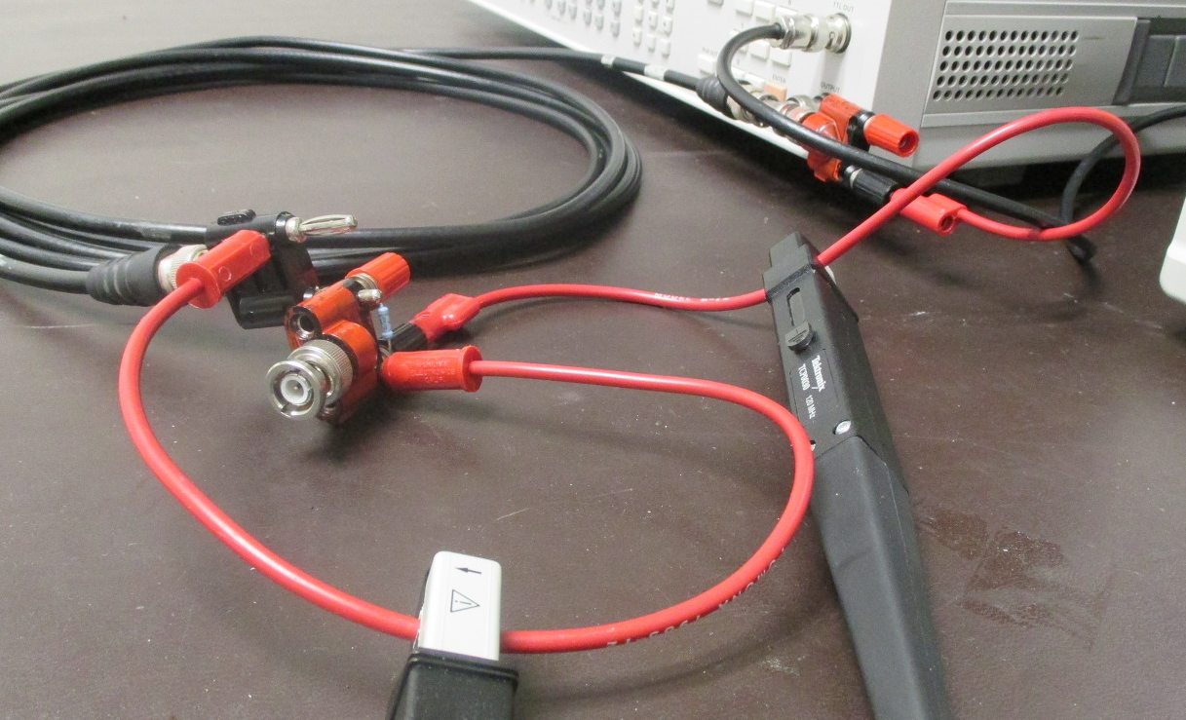
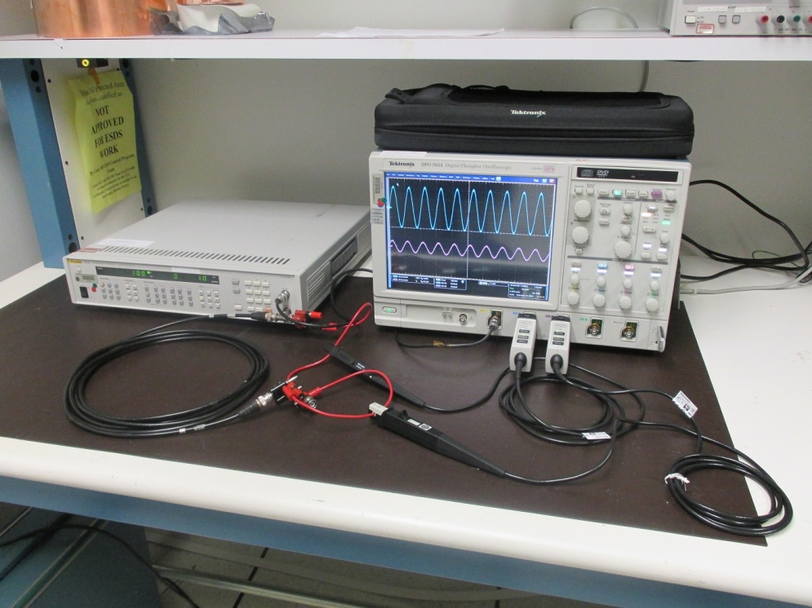
Current Return Path Test Setup (cont.)
50 Ω termination
Ground wire return current path
Shield return current path

Slide 5
Equivalent Circuit
I_{C}
R_{C}
L_{C}
I_{S}
M
V₀
R_{S}
L_{S}
R_{L}
I_{G}
R_{G}
L_{G}
I_{C} = center conductor current
I_{S} = shield return current
I_{G} = ground wire return current
I_{C} = I_{S} + I_{G}

Slide 6
Equivalent Circuit (cont.)
R_{C}
L_{C}
M
V₀
R_{S}
L_{S}
R_{L}
R_{G}
L_{G}
M = mutual inductance between center conductor and shield
M = L_{C} = L_{S}

Slide 7
A Word About Mutual Inductance
I₁
M
+
V₂
-
Mutual inductance between 2 circuits means:
Current in circuit 1 induces emf (potential) in circuit 2
- Magnitude according to equation above
- Sign according to dot convention above

Slide 8
Circuit Analysis
I_{C}
R_{C}
L_{C}
I_{S}
M
V₀
R_{S}
L_{S}
R_{L}
I_{G}
R_{G}
L_{G}
I_{C} = I_{S} + I_{G}
M = L_{S}

Slide 9
Circuit Analysis (cont.)
I_{C}
R_{C}
L_{C}
I_{S}
M
V₀
R_{S}
L_{S}
R_{L}
I_{G}
R_{G}
L_{G}
Solving for I_{S} /I_{C}:
Solving for I_{G} /I_{C}:

Slide 10
Circuit Analysis (cont.)
I_{C}
R_{C}
L_{C}
I_{S}
M
V₀
R_{S}
L_{S}
R_{L}
I_{G}
R_{G}
L_{G}
Shield return current:
Ground wire return current:
At low frequencies:
At low frequencies:
Resistive divider
At high frequencies:
At high frequencies:
Virtually all current returns on shield

Slide 11
Circuit Analysis (cont.)
I_{C}
R_{C}
L_{C}
I_{S}
M
V₀
R_{S}
L_{S}
R_{L}
I_{G}
R_{G}
L_{G}
Ratio of shield current to ground wire current:
I_{S} = I_{G} when:

Slide 12
Test #1 Setup Parameters
Shield return path:
R_{S} (measured) = 96 mΩ
L_{S} /l = 0.25 μH/m (from RG-58 coaxial cable datasheet)
l = 4.8 m
L_{S} = 1.2 μH
Ground wire return path:
R_{G} (measured) = 15 mΩ
L_{G} = 24.4 µH (next slides)

Slide 13
Inductance of Circular Loop
From Missouri University of Science and Technology inductance calculator
  http://emclab.mst.edu/inductance/
N turns
r_{w}
R
N = ~5.5
I
μ_{r} = 1
μ₀ = 4π x 10⁻⁷ H/m
R = 6 inches = 15 cm
r_{w} = 0.25 cm (shield radius)
L_{coil} = ~23.8 µH

Slide 14
Inductance of Circular Loop (cont.)
Coiled cable in series with loop completing connections to signal generator:
N turns
r_{w}
R
N = 1
μ_{r} = 1
I
μ₀ = 4π x 10⁻⁷ H/m
R_{eff} = 12 cm
r_{w} = 0.25 cm
L_{gen} = ~0.6 µH
L_{G} = L_{coil} + L_{gen} = 24.4 µH

Slide 15
Why Do We Use the Shield Radius?
I_{C}
R_{C}
L_{C}
I_{S}
M
V₀
R_{S}
L_{S}
R_{L}
I_{G} = I_{C} - I_{S}
R_{G}
L_{G}
We use the shield radius because the current in the large loop is the net current from the coax, i.e. that gets past the shield

Slide 16
Return Currents – Model for Test #1

Slide 17
Updated Equivalent Circuit
I_{C}
R_{C}
1.2 μH
I_{S}
1.2 μH
V₀
96 mΩ
1.2 μH
50 Ω
I_{G}
15 mΩ
24.4 µH

Slide 18
Test #1: Measured vs. Model

Slide 19
Test #2: 3.5-Turn Loop
N = 3.5
μ_{r} = 1
μ₀ = 4π x 10⁻⁷ H/m
R = 9 inches = ~23 cm
r_{w} = 0.25 cm (shield radius)
L_{coil} = ~16.3 µH
L_{gen} = ~0.6 µH (same as before)
L_{G} = L_{coil} + L_{gen} = 16.9 µH

Slide 20
Test #2: Measured vs. Model

Slide 21
Test #3: 1-Turn Loop
N = 1
μ_{r} = 1
μ₀ = 4π x 10⁻⁷ H/m
R_{eff} = 5 m / 2π = ~80 cm
r_{w} = 0.25 cm (shield radius)
L_{G} = 5.9 µH

Slide 22
Test #3: Measured vs. Model

Slide 23
Why Doesn’t the Ground Wire Current Go To Zero?
N = 1
μ_{r} = 1
μ₀ = 4π x 10⁻⁷ H/m
R = ~5 cm
r_{w} = 0.05 cm
L_{G} = ~300 nH
THE INDUCTANCE OF THIS LOOP LIMITS THE SHIELD CURRENT AT HIGHER FREQUENCIES

Slide 24
Observations/Summary
Measured data shows good agreement with model
  At low frequencies, current forms resistive divider with all available paths
  At high frequencies, impedance is dominated by inductance (loop area)
High inductance (large loop areas) increases likelihood of ground bounce and magnetic coupling (crosstalk) between circuits
Practical implications for circuit and system design:
  Provide deliberate low inductance (small loop area) return paths for high frequency currents
  Cabling: twisted pairs, coax
  PC board: return (-) trace immediately adjacent to send (+) trace
  Do NOT route traces over splits in ground plane
  Video type signals
    Video signals tend to be “bursty”; mix of high and low frequency content
    High frequency content will return on the shield; low frequency content will not
    Shield isn't a shield at low frequencies, and thus the low frequency video signal mixes in with ground noise which pollutes the video signal

Slide 25
Questions/Comments
Contact:
  John McCloskey
  NASA/GSFC Chief EMC Engineer
  Phone: 301-286-5498
  E-mail: John.C.McCloskey@nasa.gov

